Slide 1
BPView
a universal Business Process View UI and Business Process Manager http://github.com/ovido/BPView

Slide 2

BPView: Overview
A universal Business Process View UI
for different Monitoring Environments
Nagios, Icinga, Opsview, MonIT, Hyperic, MSCOM, Zabbix, OpenNMS, Munin, BMC, Tivoli, and more …
Including:
  Business Process Status-View (Dashboards)
  BP Config Writer for some Monitoring-Tools
  Business Process Editor

Slide 3
BPView: Roadmap

Slide 4
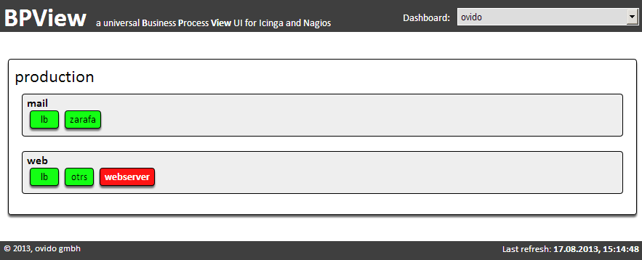

BPView: Dashboard 1
Fast and simple aggregation view for a business case
Multiple Levels for Environments, Teams, Products and Business cases

Slide 5
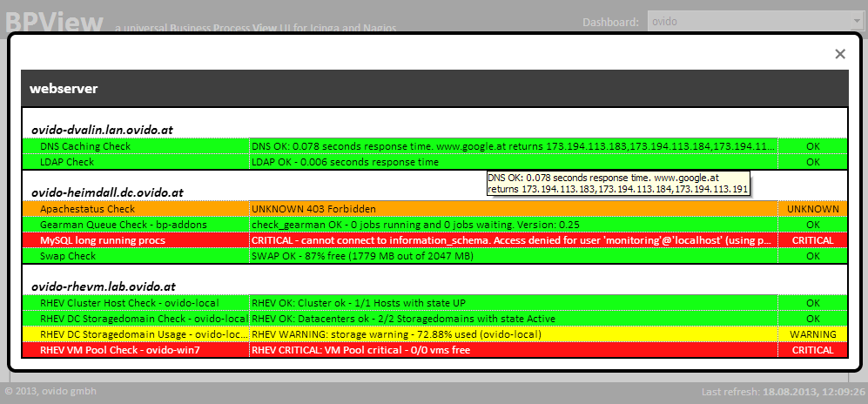
BPView: Dashboard 2
Detail View for any business case or product
Service State directly from one or more monitoring daemons

Slide 6
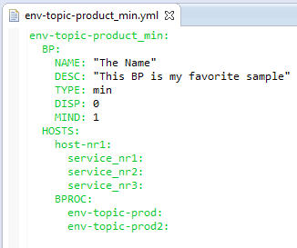

BPView: Config Writer
YML based Business Processes Products
Config generation
  for any monitoring involved tool such as Nagios, Icinga, BP-Addon and more
Config Checker and Deployment
define service {
use bpview-detail-service
service_description env-topic-product_and
check_command check_bp_status!env-topic-product_and!bpview.conf
}
# BP-Definition: The Name
# BP-Description: This BP is my favorite sample
#++++++++++++++++++++++++++++++++++++++++++++++++++++++++++
env-topic-product_min = 1 of: env-topic-prod2;env-topic-prod2 + env-topic-prod;
env-topic-prod + host-nr1;service_nr3 + host-nr1;service_nr1 + host-nr1;service_nr2
display 0;env-topic-product_min;The Name

Slide 7
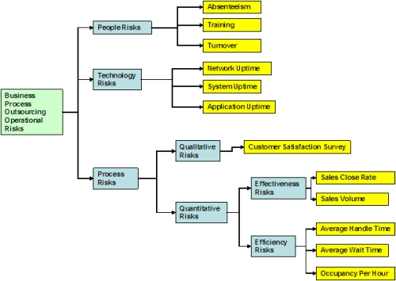
BPView: Business Process Editor
Create and edit your business processes and products
Multi-Level BP's
Proceeds Services from one or more monitoring systems directly
Servicechecks from different Systems useable in one BP
AND, OR, and MIN correlations
Authentification via AD or LDAP
Upcomming feature
Group / Team based
Extensive Right-Management for Groups and Users (Stage 4)

Slide 8
BPView: Business Process Editor
Upcomming feature

Slide 9
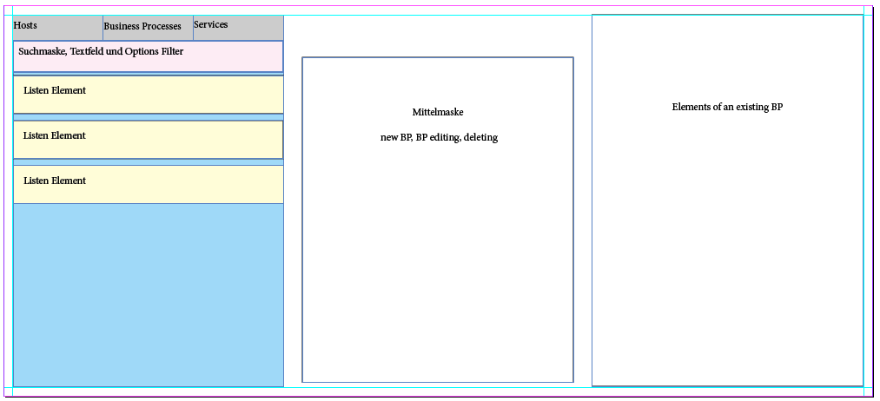
BPView: Business Process Editor
Upcomming feature

Slide 10
Thank you
Maintainer:
  Peter Stöckl
  p.stoeckl@ovido.at
  René Koch
  r.koch@ovido.at

